Slide 1
Animations and its Branches….

Slide 2
Conventional & Computer Assisted Animation

Slide 3
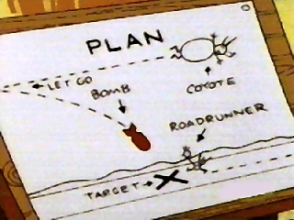
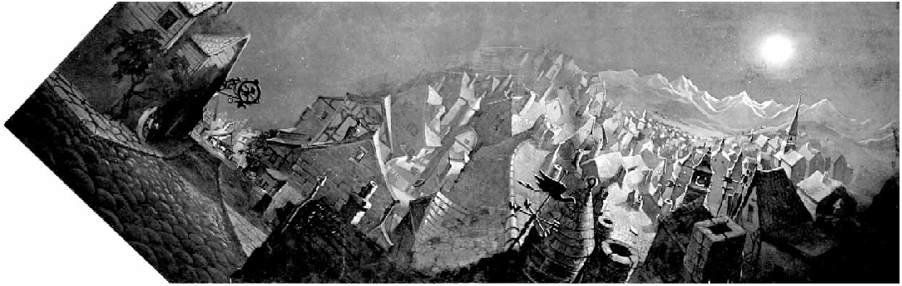
Draw each frame of the animation
great control
tedious
Reduce burden with cel animation
layer
keyframe
inbetween
cell panoramas (Disney’s Pinocchio)
...
ACM © 1997 “Multiperspective panoramas for cel animation”
Lecture 21
Slide 2
6.837 Fall 2001

Slide 4
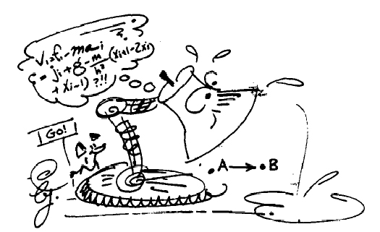
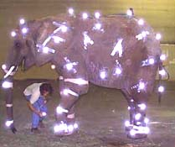
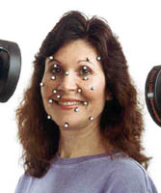
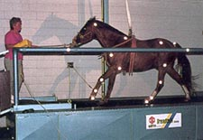
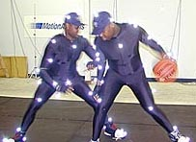
Computer-Assisted Animation
Physically Based Animation
Assign physical properties to objects
(masses, forces, inertial properties)
Simulate physics by solving equations
Realistic but difficult to control
Motion Capture
Captures style, subtle nuances and realism
You must observe someone do something
ACM© 1988 “Spacetime Constraints”

Slide 5
Design Of Animation Sequence

Slide 6
Animation means giving life to any object in computer graphics. It has the power of injecting energy and emotions into the most seemingly inanimate objects.
Animation Techniques:
Animators have invented and used a variety of different animation techniques. Basically there are six animation technique.
which we would discuss one by one in this section.

Slide 7
Traditional Animation frame by frame
Traditionally most of the animation was done by hand. All the frames in an animation had to be drawn by hand. Since each second of animation requires 24 frames film, the amount of efforts required to create even the shortest of movies can be tremendous.
Key framing
In this technique, a storyboard is laid out and then the artists draw the major frames of the animation. Major frames are the ones in which prominent changes take place. They are the key points of animation. Key framing requires that the animator specifies critical or key positions for the objects. The computer then automatically fills in the missing frames by smoothly interpolating between those positions.
Procedural
In a procedural animation, the objects are animated by a procedure − a set of rules − not by key framing. The animator specifies rules and initial conditions and runs simulation. Rules are often based on physical rules of the real world expressed by mathematical equations.
Behavioral
In behavioral animation, an autonomous character determines its own actions, at least to a certain extent. This gives the character some ability to improvise, and frees the animator from the need to specify each detail of every character's motion.

Slide 8
Performance Based Motion Capture
Another technique is Motion Capture, in which magnetic or vision-based sensors record the actions of a human or animal object in three dimensions. A computer then uses these data to animate the object.
This technology has enabled a number of famous athletes to supply the actions for characters in sports video games. Motion capture is pretty popular with the animators mainly because some of the commonplace human actions can be captured with relative ease. However, there can be serious discrepancies between the shapes or dimensions of the subject and the graphical character and this may lead to problems of exact execution.

Slide 9
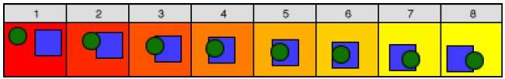
Key Framing
A key frame is a frame where we define changes in animation. Every frame is a key frame when we create frame by frame animation. When someone creates a 3D animation on a computer, they usually don’t specify the exact position of any given object on every single frame. They create key frames.

Slide 10
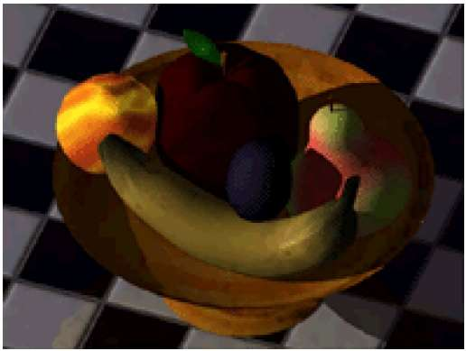
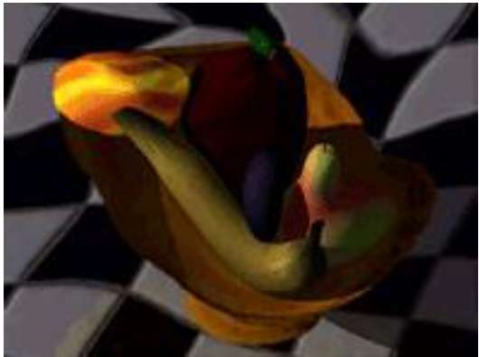
Morphing
The transformation of object shapes from one form to another form is called morphing. It is one of the most complicated transformations.
Normal version Wrapped Version

Slide 11
Animation Functions

Slide 12
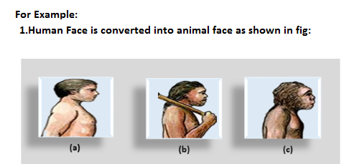
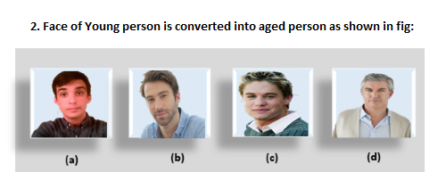
1. Morphing: Morphing is an animation function which is used to transform object shape from one form to another is called Morphing.
It is one of the most complicated transformations. This function is commonly used in movies, cartoons, advertisement, and computer games.

Slide 13
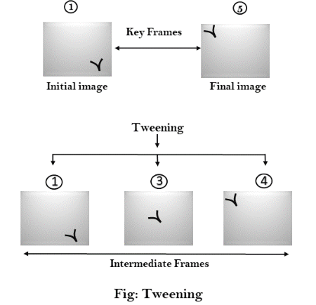
2. Wrapping: Wrapping function is similar to morphing function. It distorts only the initial images so that it matches with final images and no fade occurs in this function.
3. Tweening: Tweening is the short form of 'in betweening.' Tweening is the process of generating intermediate frames between the initial & last final images. This function is popular in the film industry.

Slide 14
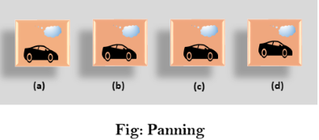
4. Panning: Usually Panning refers to rotation of the camera in horizontal Plane. In computer graphics, Panning relates to the movement of fixed size window across the window object in a scene. In which direction the fixed sized window moves, the object appears to move in the opposite direction as shown in fig:
If the window moves in a backward direction, then the object appear to move in the forward direction and the window moves in forward direction then the object appear to move in a backward direction.

Slide 15
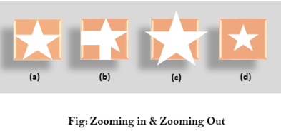
5. Zooming: In zooming, the window is fixed an object and change its size, the object also appear to change in size. When the window is made smaller about a fixed center, the object comes inside the window appear more enlarged. This feature is known as Zooming In.
When we increase the size of the window about the fixed center, the object comes inside the window appear small. This feature is known as Zooming Out.

Slide 16


Slide 17

Thank Y u….
Presented By:
K.M ngia.
19MCA36.
II MCA “B” Batch.

